Slide 1

On the Spot
Software Proposal
Presented by:
That’s No Moon
Elise O’Banion
Chase Lawrence
Samuel Lewright
Blake Robinett

Slide 2
Overview
Analysis of Project
Team Principles
Key Terms & System Research
Requirements
Security Measures
Access Controls
Network Description
System Environment, Database, and Interface Design
New System Logo
Personas
Mockups
Database Design & Management
Project Plan
Subsystem Development Order
Subsystem Use Cases
Iteration Schedule
Work Breakdown Schedule
Gantt Chart

Slide 3
Analysis of Project

Slide 4
Problem & Solution
Problem
A courier service, On the Spot, needs a new system for their customers and employees.
Solution
A custom system that allows customers to order and track shipments, get shipment notifications, view account history, and pay online, as well as allows employees to edit and add information and easily notify customers about deliveries.

Slide 5

Team Principles
High quality work
Confidentiality
Professionalism
Honesty
Trustworthiness

Slide 6

Key Terms
On the Spot
Courier
Client
Parcel
Delivery
Route
Warehouse
Signature
Delivery Truck
Commissioner
System
FURPS+
Hypertext Transfer Protocol Secure
Log
System

Slide 7

Stakeholders
Current
Commissioner
Warehouse coordinator
Delivery drivers
Customers
IT Technicians
Potential Stakeholders:
Potential investors
Customer service representatives
Managers
Future employees
Potential customers

Slide 8

System Research
Objects or things involved in the courier process
Delivery trucks
Customers
Warehouse
Office
Individuals affected by or contributing to the courier process:
Delivery drivers
Warehouse employees
Owner
Clients

Slide 9
System Research (cont.)
Tasks associated with the courier process:
Answering calls
Pricing estimates
Delivery estimates
Delivery and pickup of parcels
Organizing parcels

Slide 10

System Research Questions
What should the system do and not do?
How should the system look?
What platforms should the system be compatible with?
What in the system would and would not benefit the business?

Slide 11
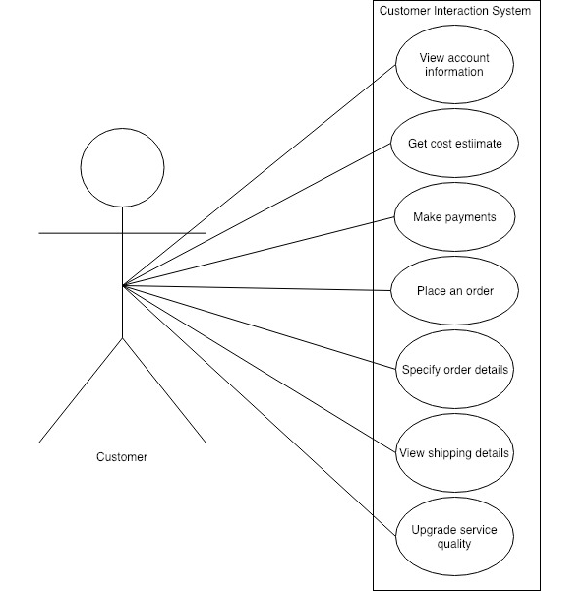
Use Cases

Slide 12
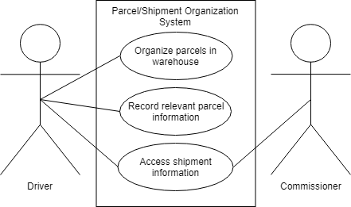
Use Cases (cont.)

Slide 13

Technology, Communication, & Hardware Requirements
Customers can place delivery requests
Customers can contact different areas of the company
Any browser would be able to access and use the website
System would use cloud computing to host the system

Slide 14
Functional Requirements
The system will have the ability place orders through an online website.
The system will have the ability to store the information collected.
The system will allow the user to track their package and see an estimated time of arrival.

Slide 15
Functional Requirements (cont.)
The system will allow the user to get an estimate on how much it will cost to ship their package without having to place an order.
The system will allow the drivers to access relevant information.
The system will allow the user to pay online.
The system will notify the user when their parcel has been delivered.

Slide 16


Non-Functional Requirements
Usability
The system will allow users to find what they want within three clicks.
Reliability
The system will be available for delivery requests all hours of the day.
Performance
The system will send data within a reasonable time span.

Slide 17
Non-Functional Requirements (Cont.)
Security
The system will need to include hypertext transfer protocol secure.
The system will need to include a username and password to ensure a secure transaction.
The system will need to log any data for the case of information loss.
Interface (+)
The system will need to fit on mobile browsers.
Supportability (+)
The system will need to connect to all web browsers.
Physical (+)
The system will need to be hosted on a computer.

Slide 18

Security Measures
Require customers to create a user account & password
Restrict access
Require strong passwords
Encrypt communication between system components and entities outside the system
Printed labels must be unique per delivery
Customers sign off on deliveries

Slide 19
Security Measures (cont.)
System should be thoroughly tested and robust
Extra security questions and more intensive password requirements for administrative accounts
Security education for employees
Hypertext Transfer Protocol Secure implementation

Slide 20

Access Controls
Customers
Access control list
Barred from certain features and information
Multi-factor authentication
Usernames and passwords
2 factor verification
Truck Drivers
Access control list
Allowed certain features and information
Multi-factor authentication
Usernames and passwords
2 factor verification

Slide 21
Access Controls (cont.)
Commissioner
Access control list
Allowed all features and information
Multi-factor authentication
Usernames and passwords
2 factor verification
Challenge questions

Slide 22
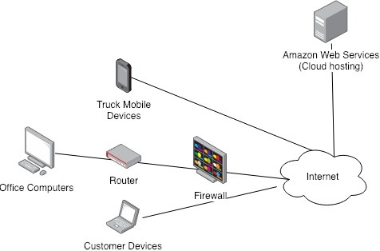
Network Description and Diagram

Slide 23
System Environment, Database, and Interface Design

Slide 24

New System Logo

Slide 25
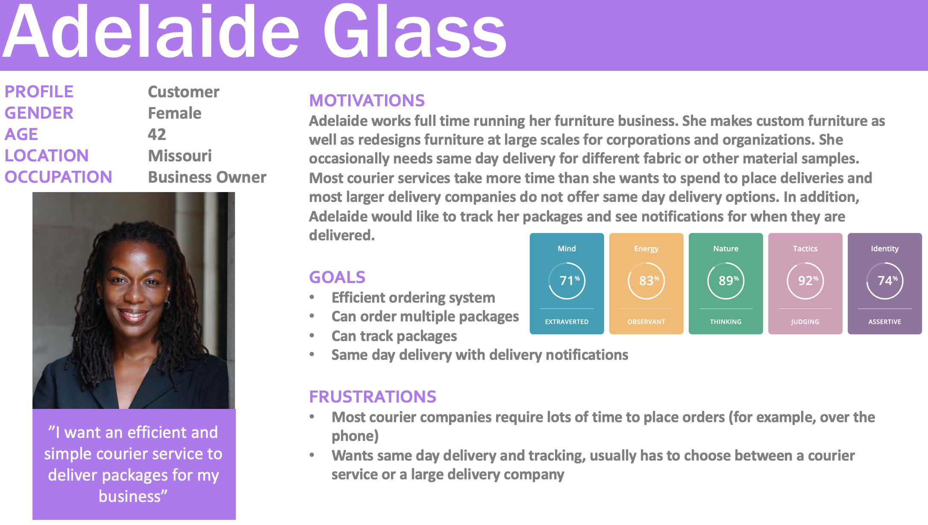

Slide 26
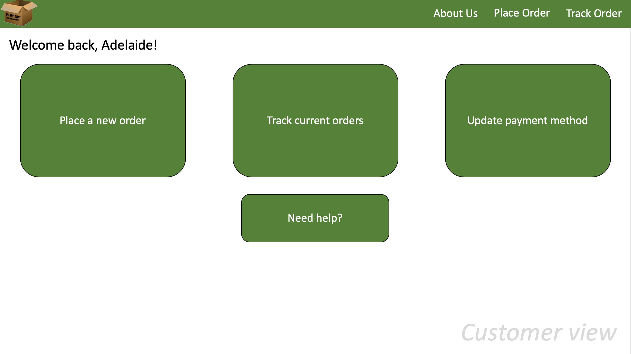

Slide 27
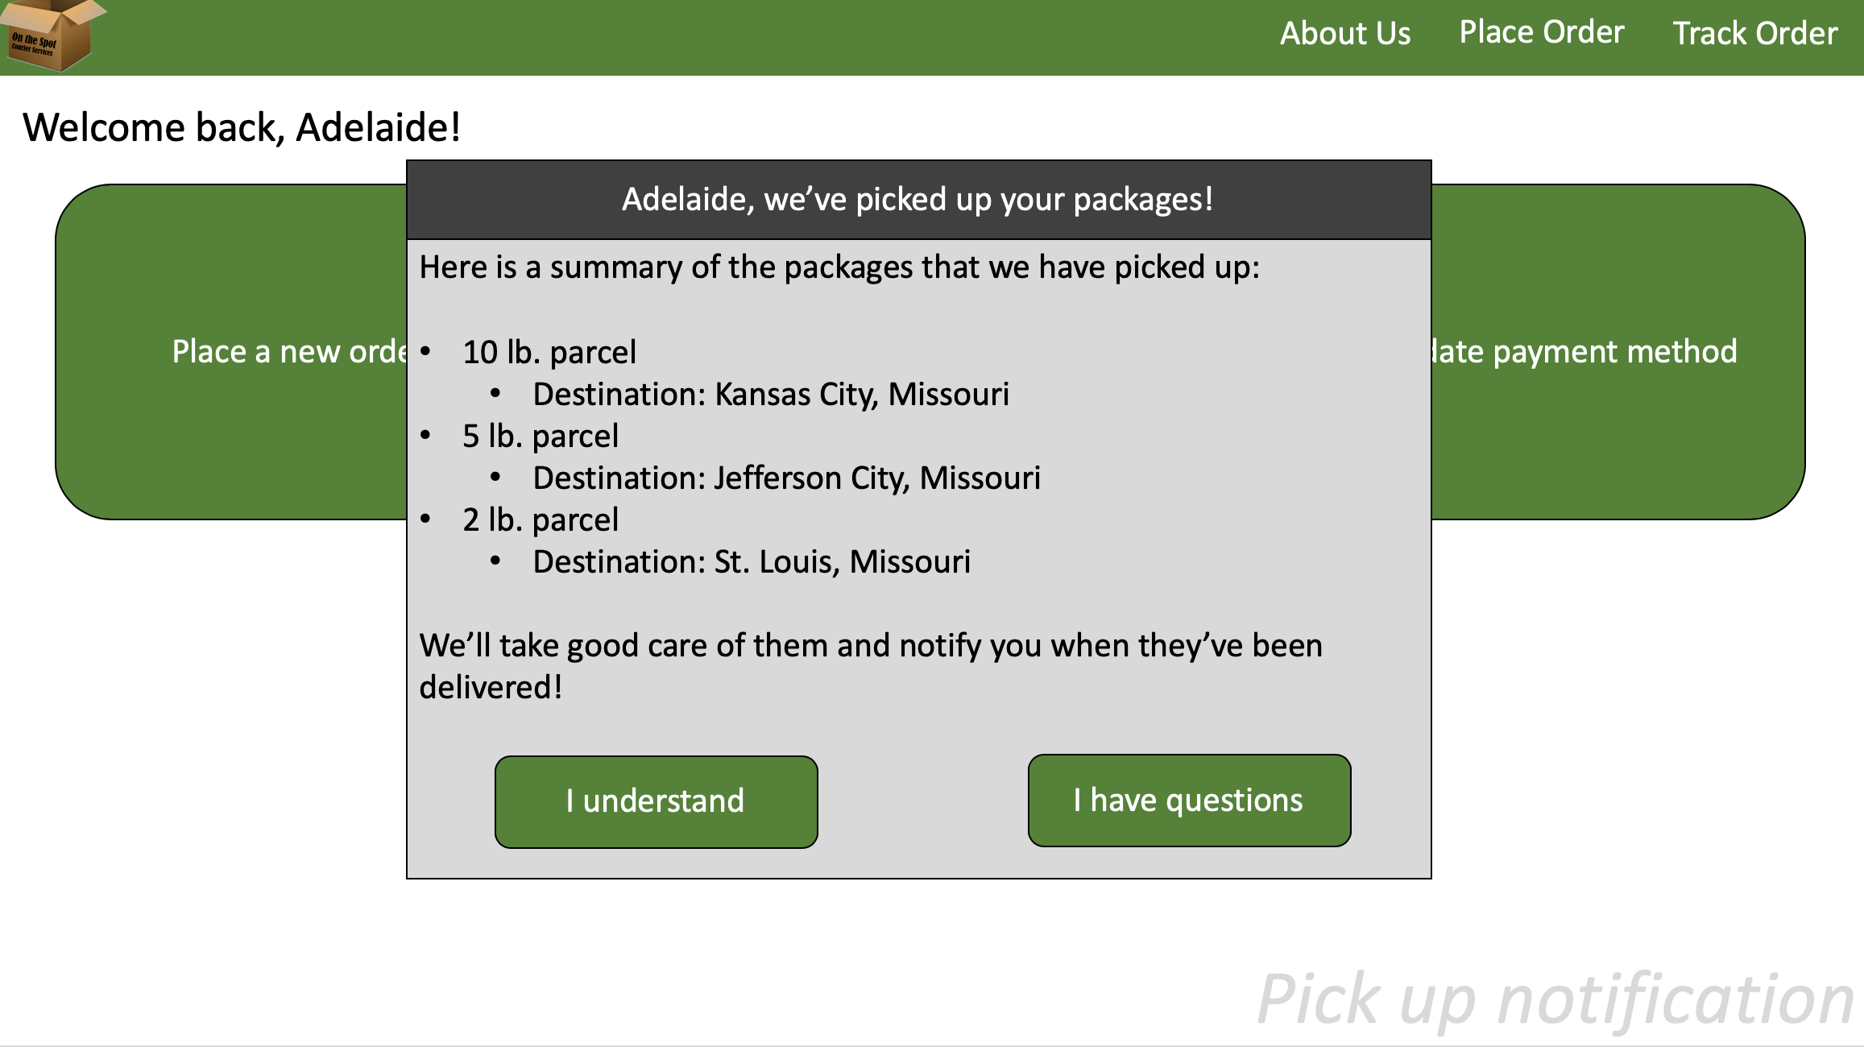

Slide 28
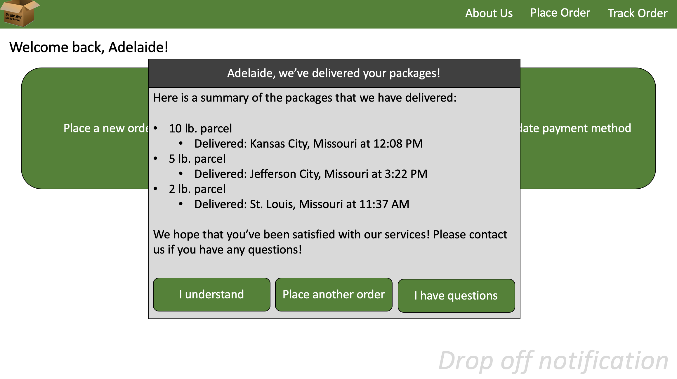

Slide 29
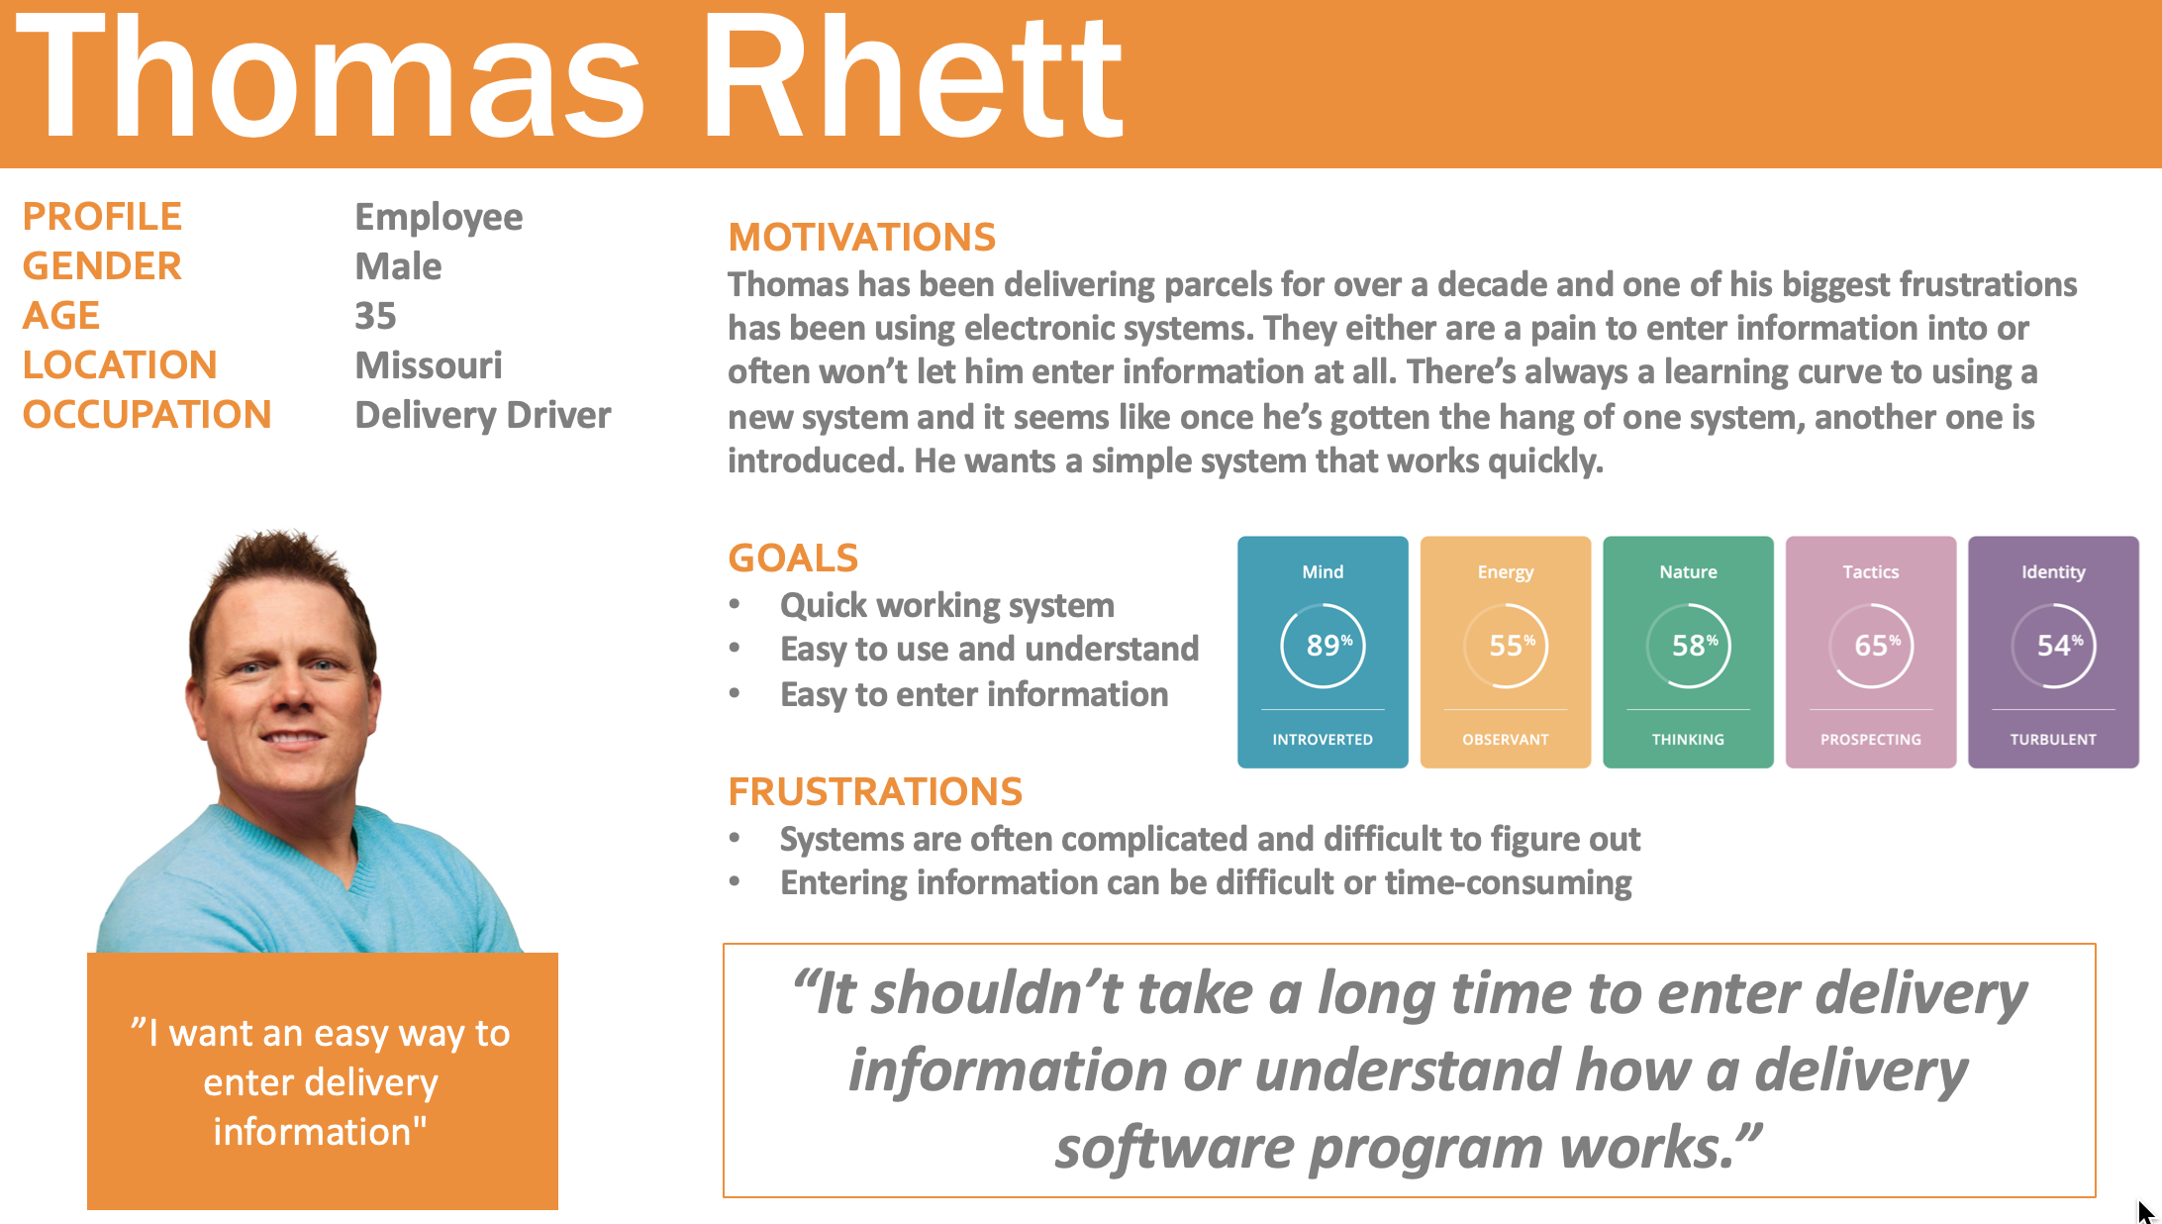

Slide 30
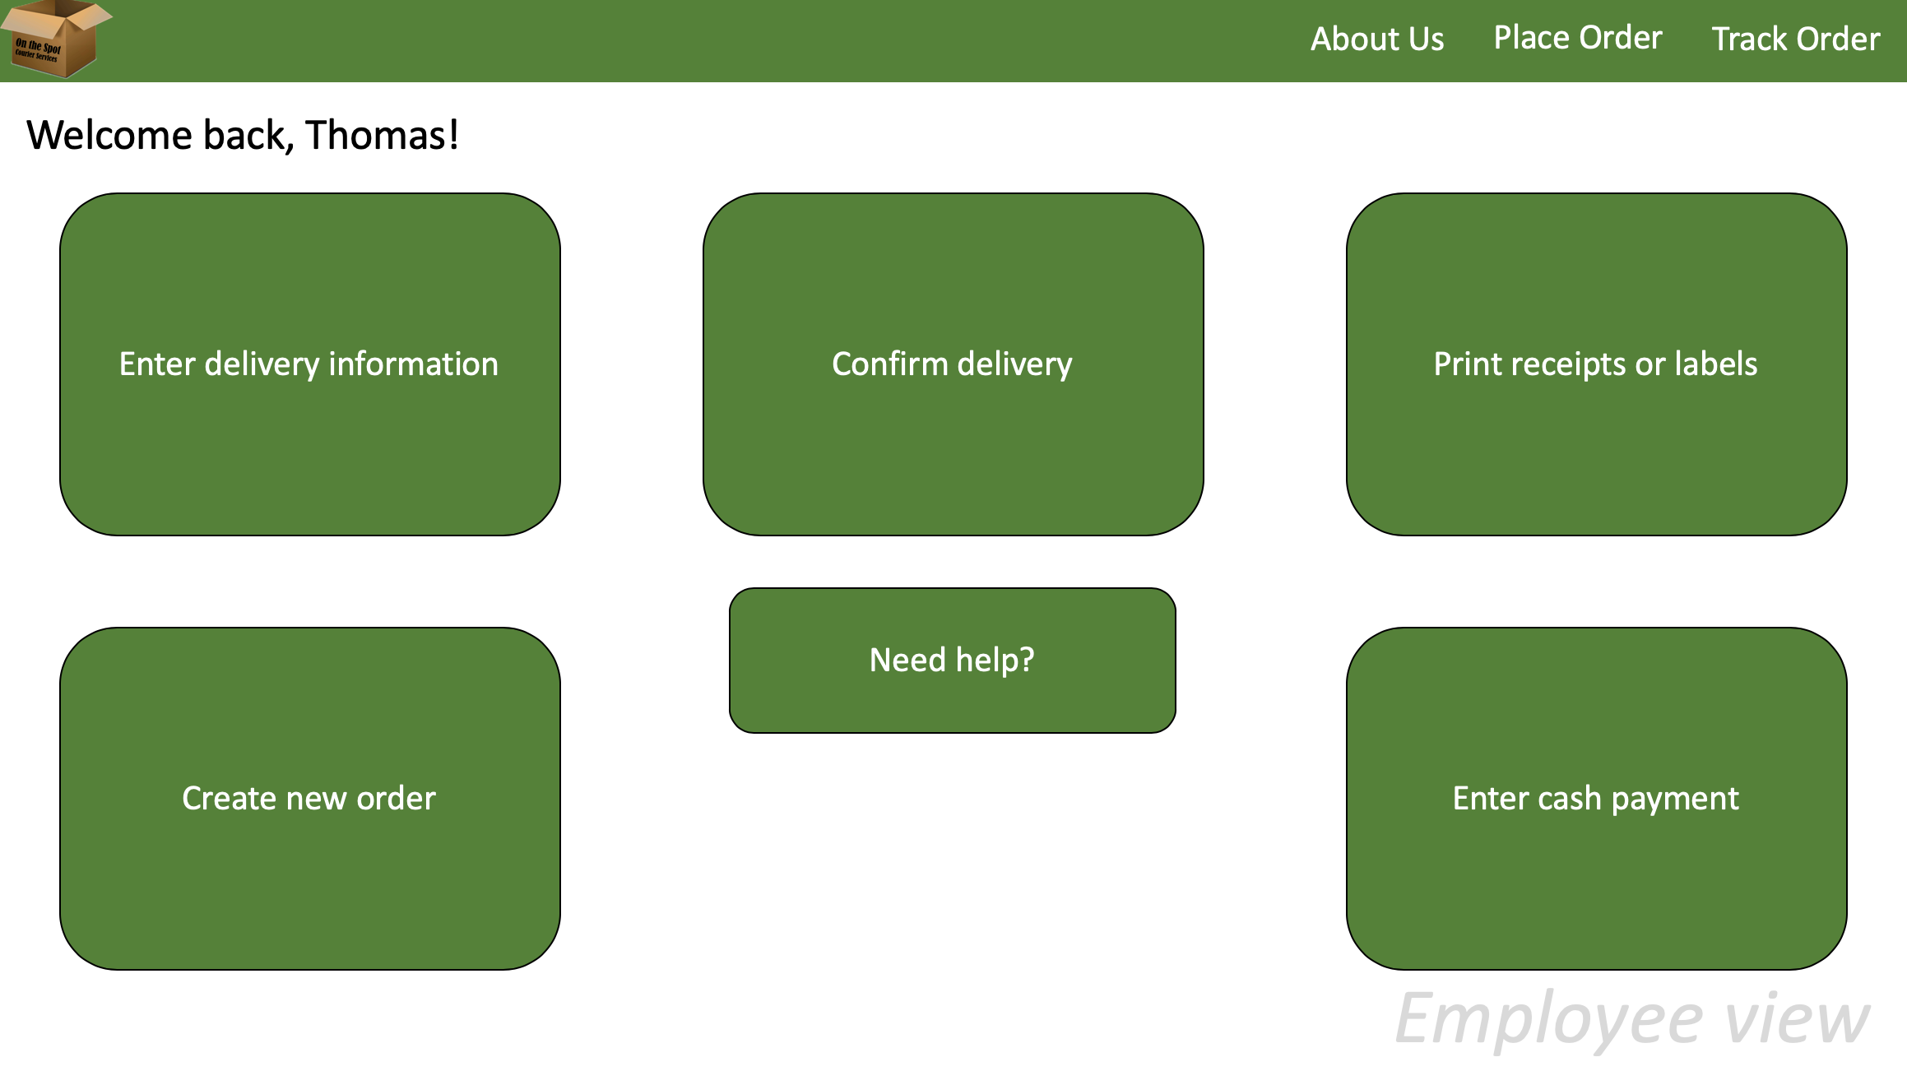

Slide 31
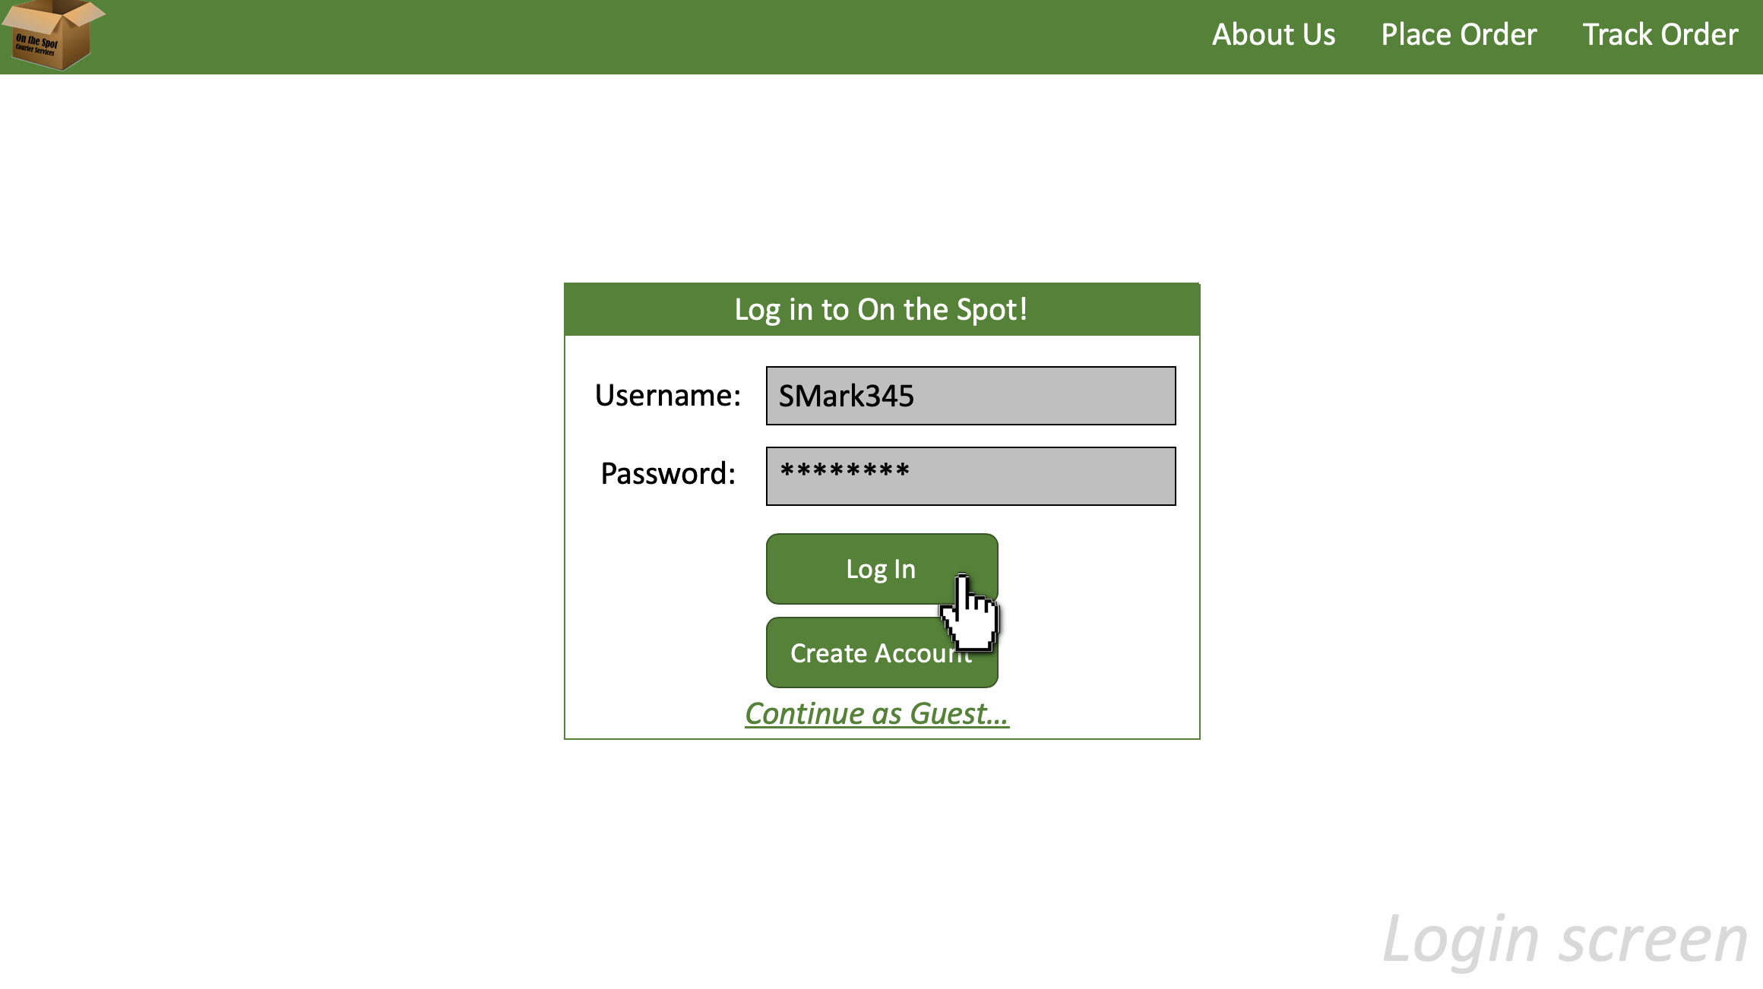

Slide 32
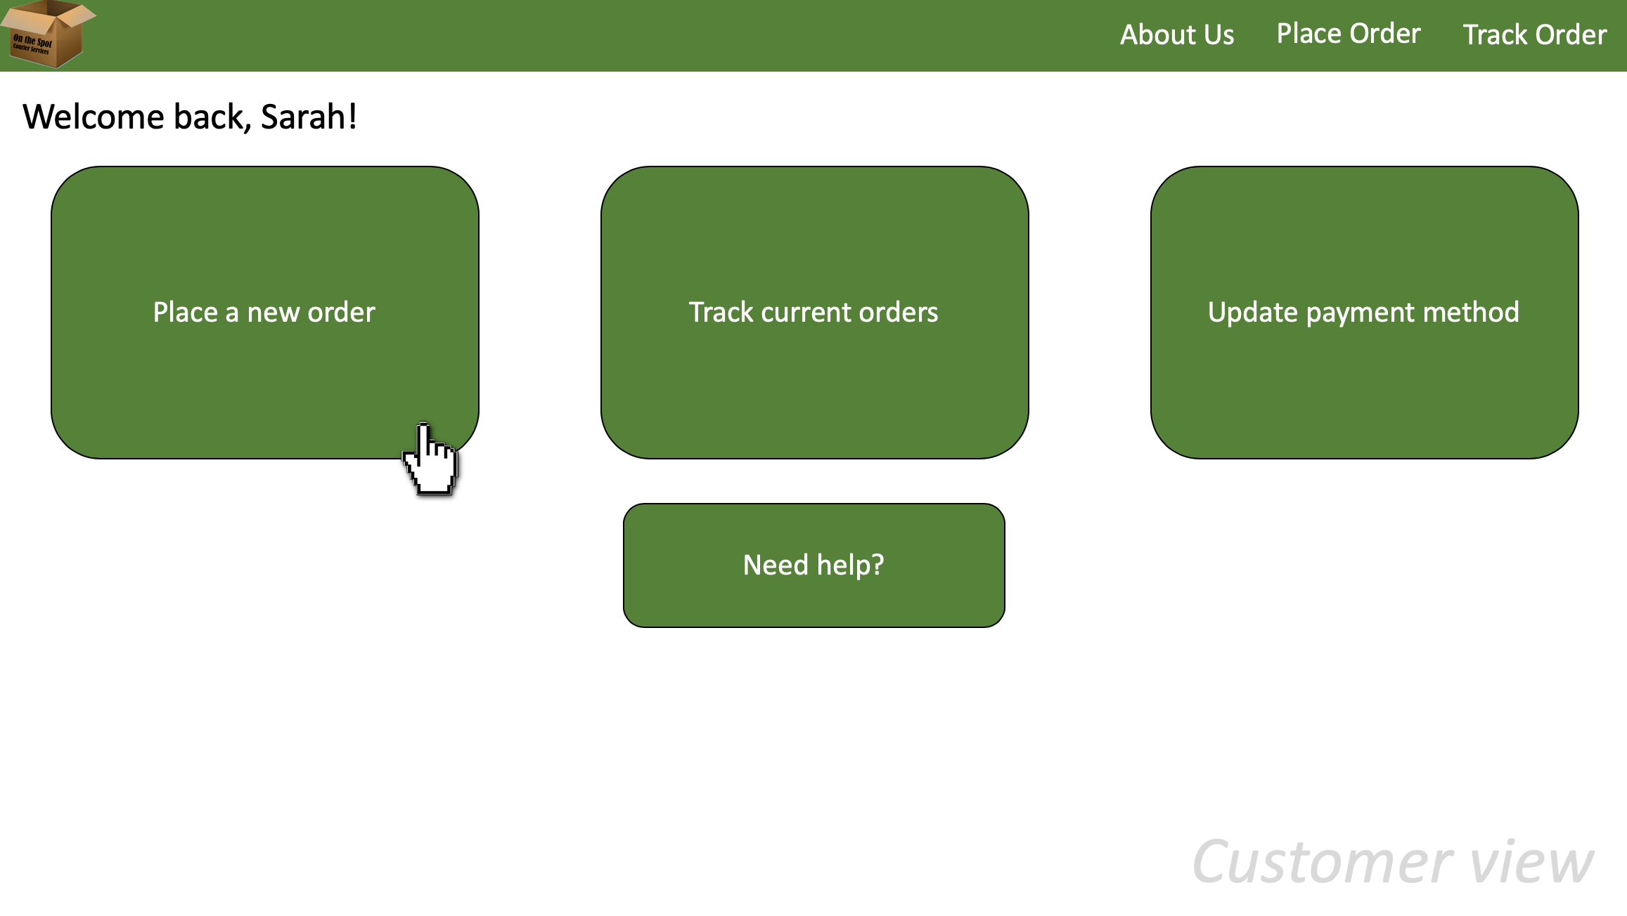

Slide 33
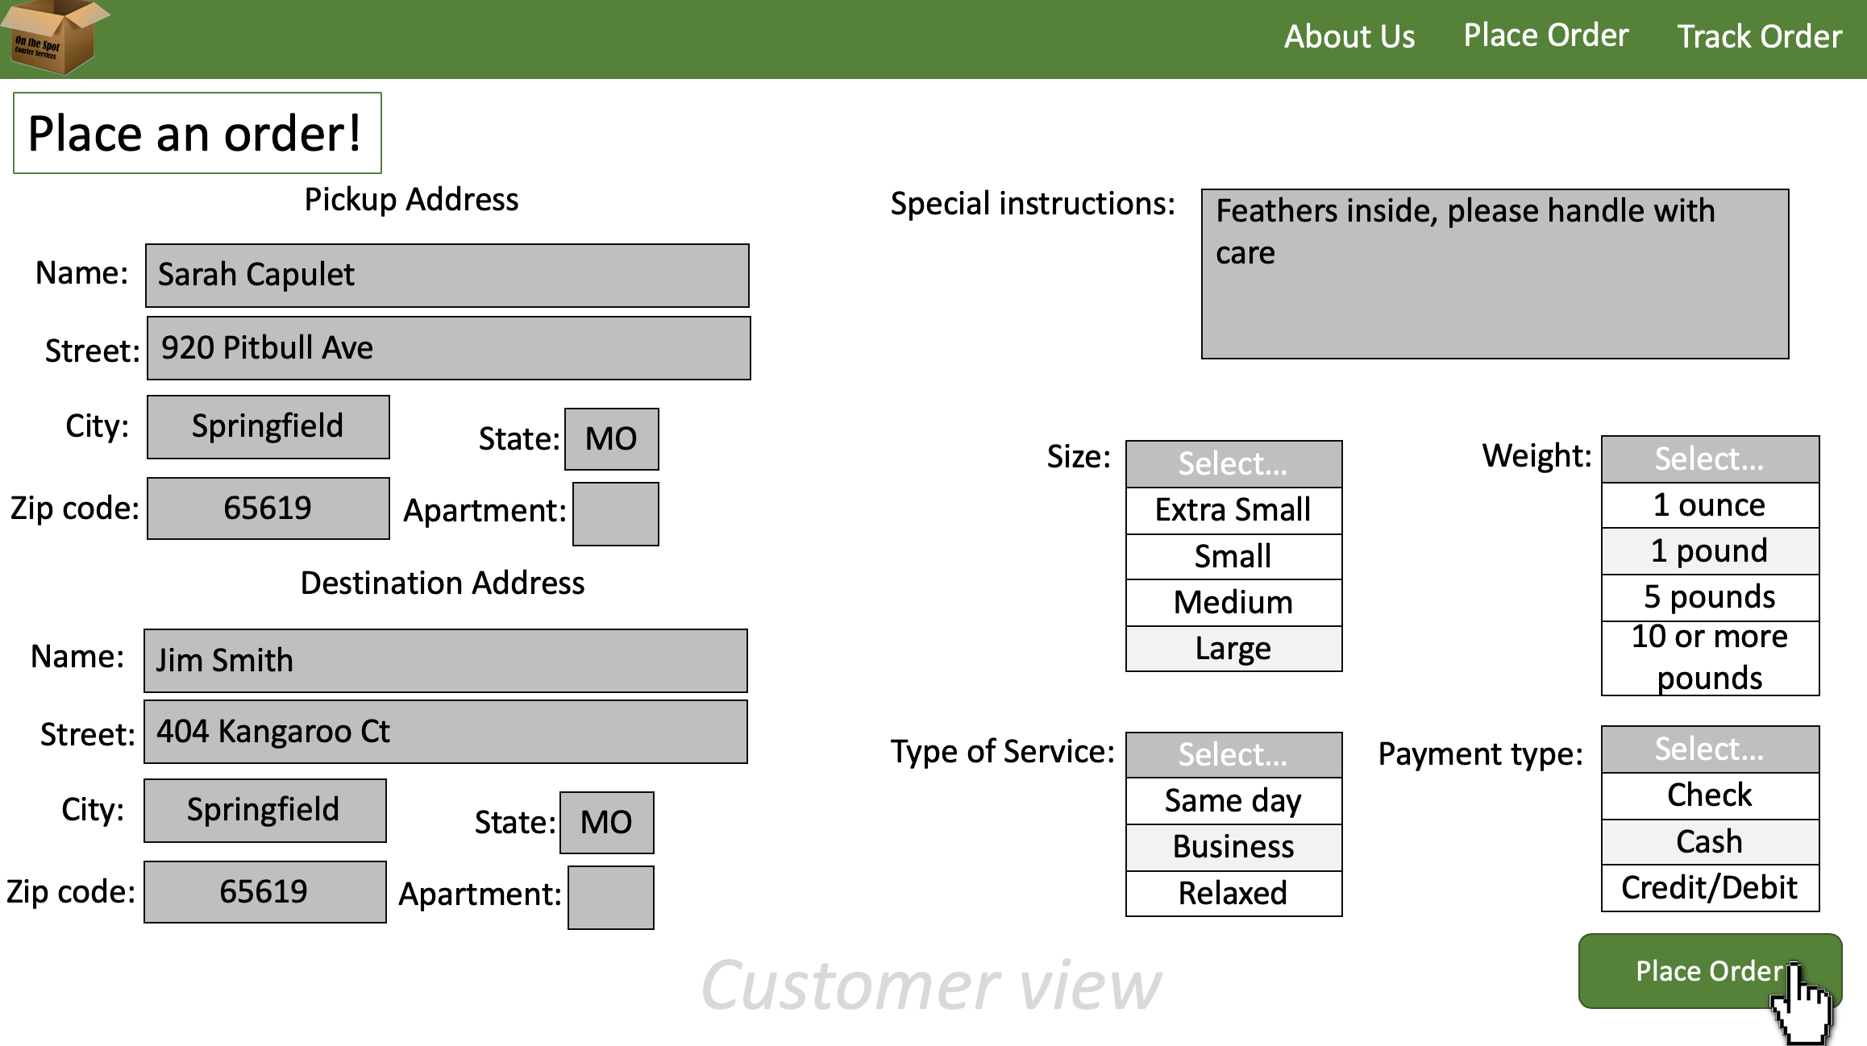

Slide 34
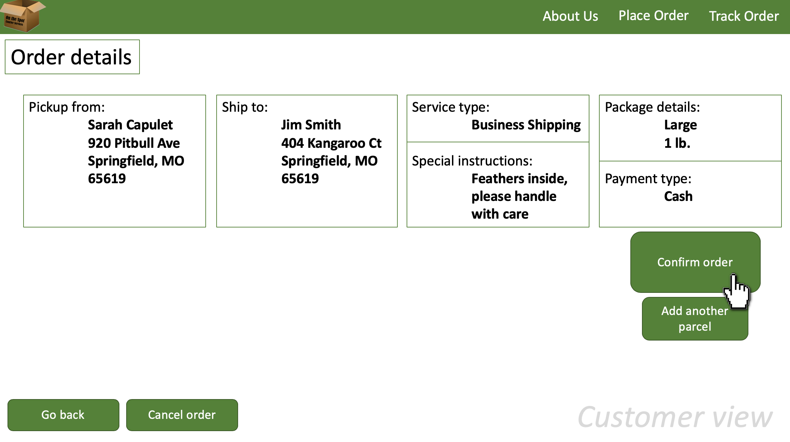

Slide 35
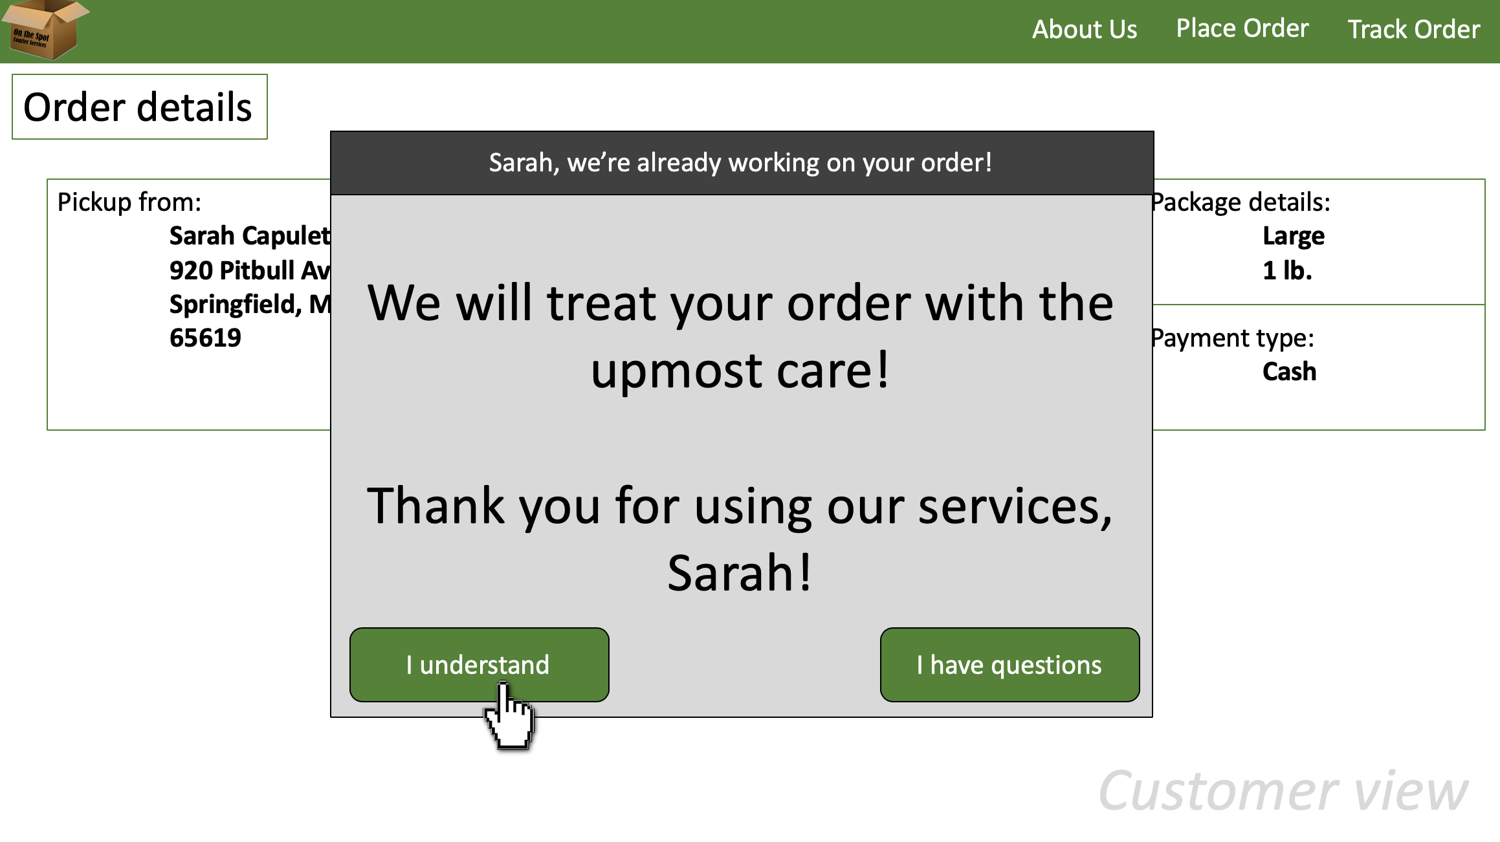

Slide 36
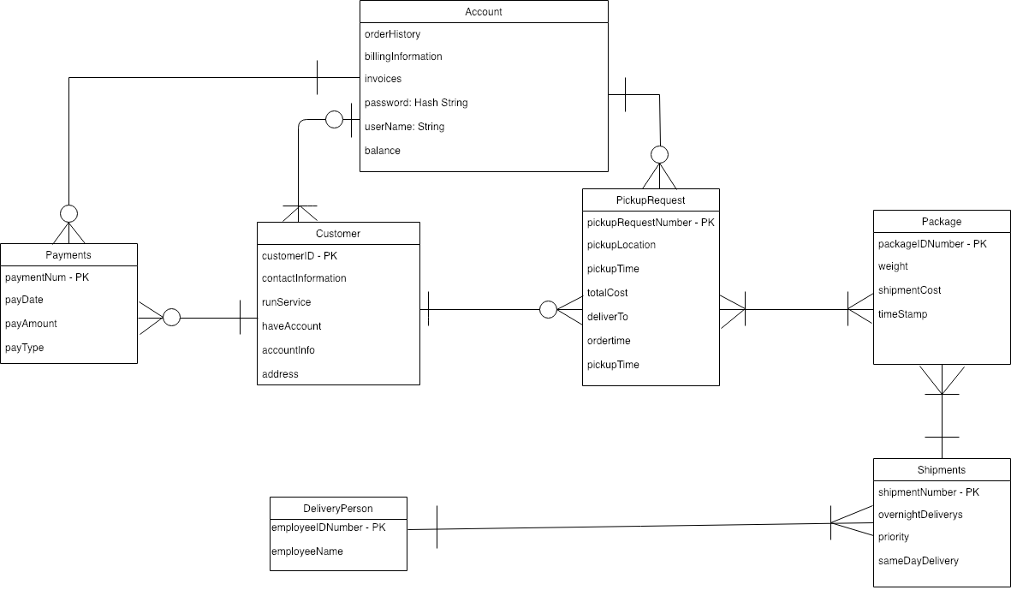
Entity-Relationship Diagram

Slide 37
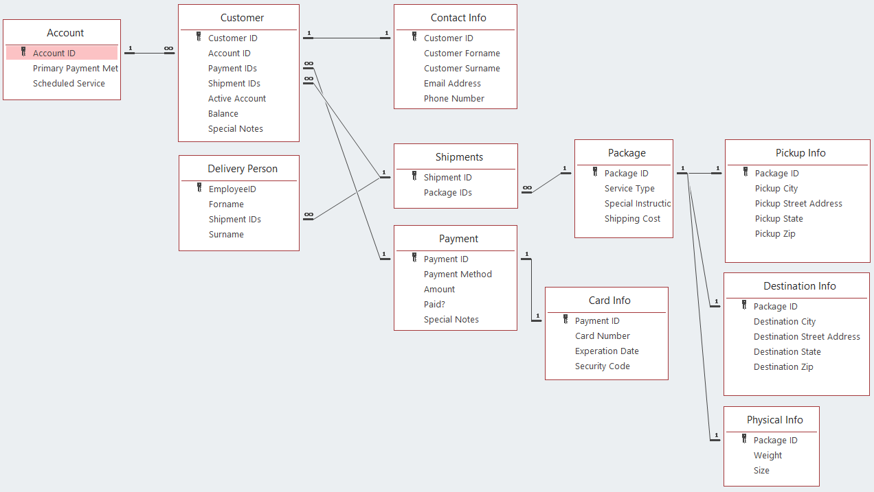
Database Schema

Slide 38



Database Administrator and Data Administrator
On the Spot will need to hire:
Database Administrator (DBA)
Data Administrator (DA)

Slide 39
Project Plan

Slide 40

Subsystem Development Order
Routing and Scheduling
Customer Account
Pickup Request
Package Delivery
Administration

Slide 41

Routing and Scheduling Subsystem
Use system on multiple devices
Check delivery/order details
Organize parcels in warehouse
Know which parcel is which (identification)
Easily locate parcels (organization)

Slide 42

Customer Account Subsystem
Create an account
Use system on multiple devices
View account/order history and details
Customers can pay bills

Slide 43
Pickup Request Subsystem
Place an order
Get a cost estimate
Upgrade service quality
Add additional service requests with orders
Customer wants immediate pickup
Customer wants to schedule a later time in the day for pickup

Slide 44

Package Delivery Subsystem
Track parcels
See estimated time of arrival
Notify when parcels arrive
Record relevant information
Easily identify parcels

Slide 45

Administrative Subsystem
Track parcels
View account/order history and details
Check delivery/order details
Modify data directly
Update system

Slide 46
Iteration Schedule
Easy to see version with selected use cases and tasks
Iteration 1 | Iteration 2 | Iteration 3 | Iteration 4
10 Weeks | 10 Weeks | 10 Weeks | 5 Weeks
5. Get a cost estimate 6. Place an order 7. Create an account | 11. Modify data directly 13. See estimated time of arrival 18. Meet with small group of regular customers | 19. Track parcels 22. Customers can pay bills | 27. Release accepted version 28. End user training

Slide 47
Iteration Schedule
Complete iteration schedule
Iteration 1 | Iteration 2 | Iteration 3 | Iteration 4
10 Weeks | 10 Weeks | 10 Weeks | 5 Weeks
1. View account/order history and details 2. Check delivery/order detail 3. Record relevant information 4. Easily identify parcels 5. Get a cost estimate 6. Place an order 7. Create an account 8. Organize parcels in warehouse 9. Know which parcel is which (identification) 10. Easily locate parcels (organization) | 11. Modify data directly 12. Update system 13. See estimated time of arrival 14. Notify when parcels arrive 15. Upgrade service quality 16. Add additional service requests with orders 17. Meet with the owner 18. Meet with small group of regular customers | 19. Track parcels 20. Customer wants immediate pickup 21. Customer wants to schedule a later time in the day for pickup 22. Customers can pay bills 23. Use system on multiple devices | 24. Perform acceptance tests with users 25. Set up user “simulated live environment” 26. Test in “simulated live environment” 27. Release accepted version 28. End user training

Slide 48

Work Breakdown Structure
Project Planning
Develop WBS and build a schedule and then plan the work - ½ day.
Analysis Tasks
Meet with the owner - ½ day.
Meet with small group of regular customers - 1 day.
Model user interactions - 2 days.
Define required informations and data elements - 1 day.
III. Design Tasks
Design database schema - 1 day.
Identify program classes and methods - ½ day.
Design screen layouts and develop cross-links - 2 days.

Slide 49
Work Breakdown Structure (cont.)
Build Tasks
Build database - 2 days.
Write code - 4 days.
Build test data - 1 day.
Perform acceptance tests with users - 1 day.
Perform team introspection - 1 day.
Set up user “simulated live environment” - 2 days.
Test in “simulated live environment” - 1 day.
Release accepted version - 1 day.

Slide 50
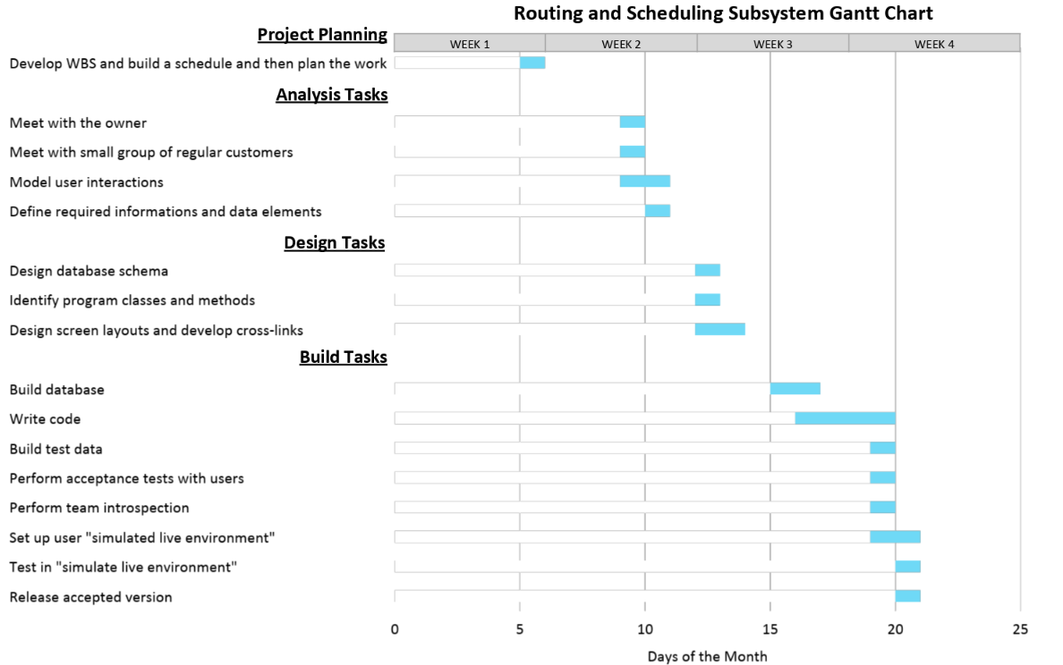
Gantt Chart

Slide 51

Questions?

